Slide 1

Introduction to RTOS
DAY 4
EMBEDDED SYSTEM DESIGN & IoT-Master Class

Slide 2
What You will learn Today?
How OS Works
Desktop OS Vs RTOS
Real Time Systems
Single Task Vs Multi tasking
Scheduling Algorithms in RTOS
Semaphores
Task Communication

Slide 3
Day 4 Introduction to RTOS

Slide 4
Mindset Lesson for the Day
Focus is the Most valuable asset, not the time.
Focus on one thing(WIG) –Apply 80/20 Rule
Exercise
Write down everything you can think of that distracts you from getting work done on achieving the Goal.

Slide 5
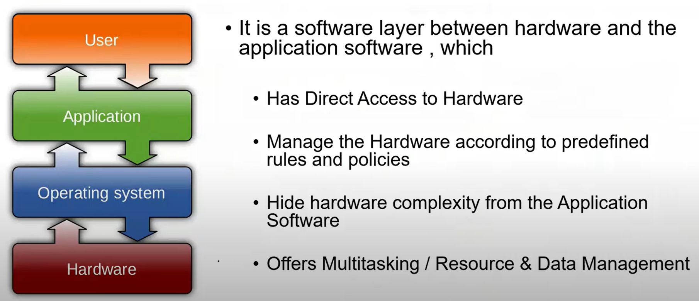
What is an Operating System

Slide 6
Examples of OS
Microsoft Windows
Linux
Mac Os
Android
Ios
Embedded Os

Slide 7
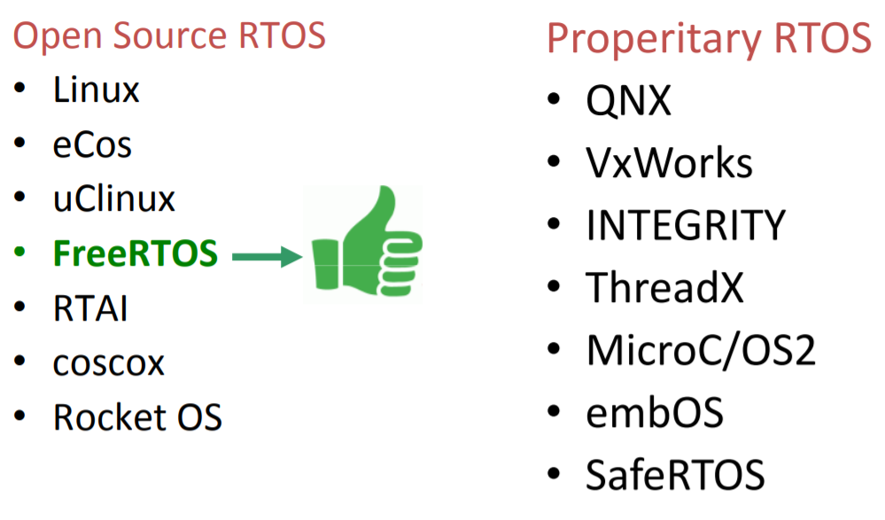
List of RTOS

Slide 8
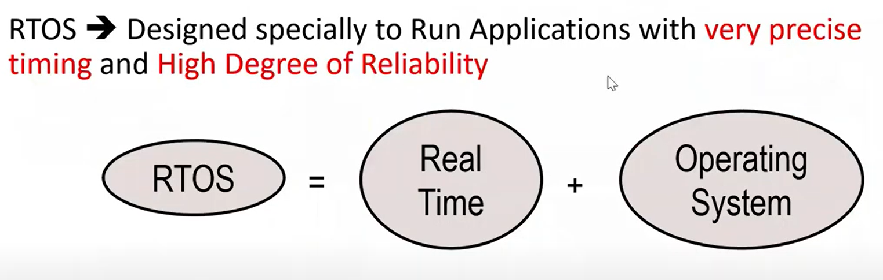
What is an RTOS

Slide 9
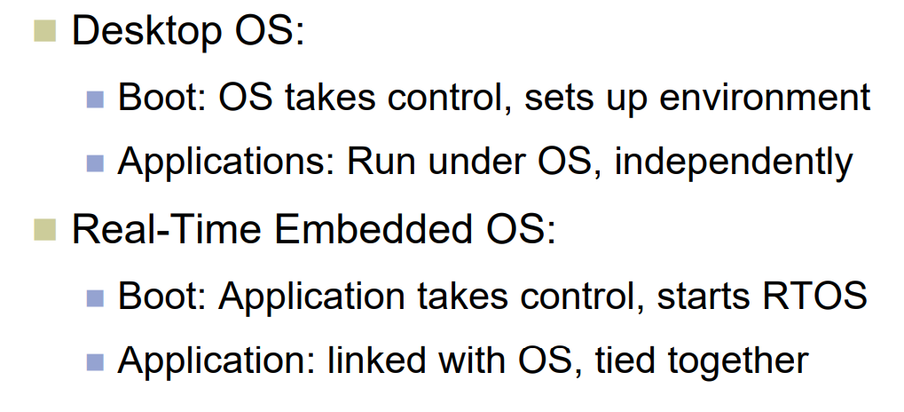
Desktop Vs RTOS

Slide 10
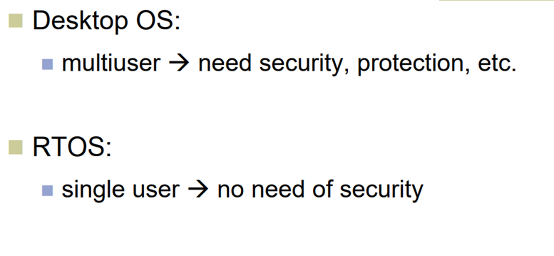
Desktop Vs RTOS

Slide 11
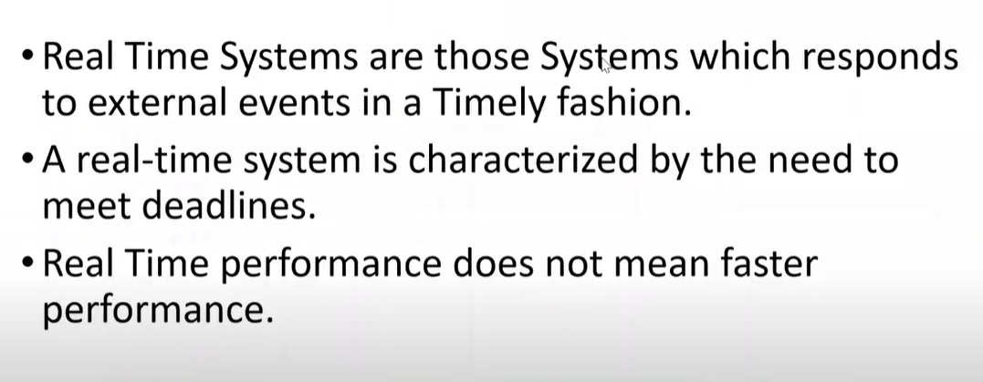
What is an Real Time System

Slide 12
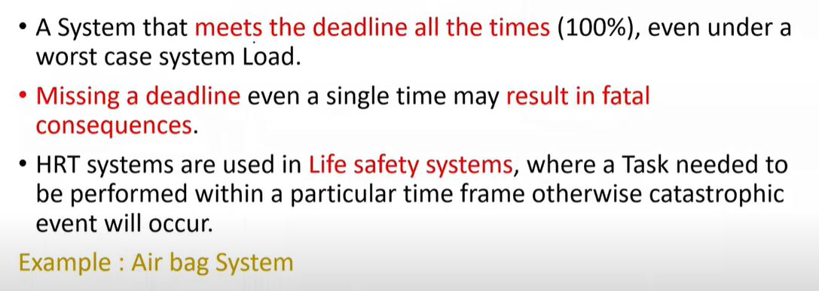
Hard Real Time

Slide 13
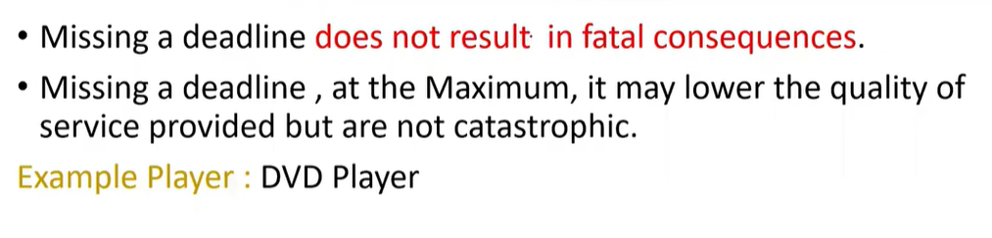
Soft Real Time

Slide 14
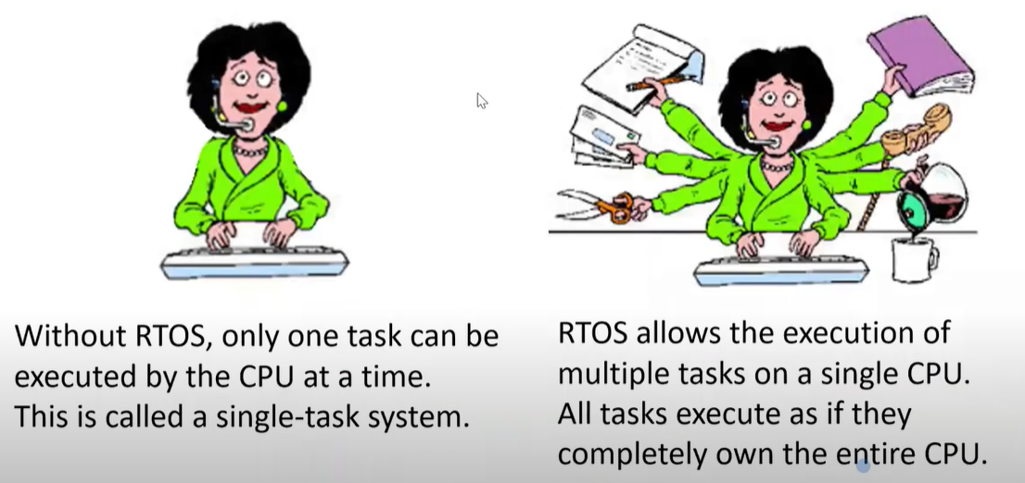
Single Tasking Vs Multi Tasking

Slide 15
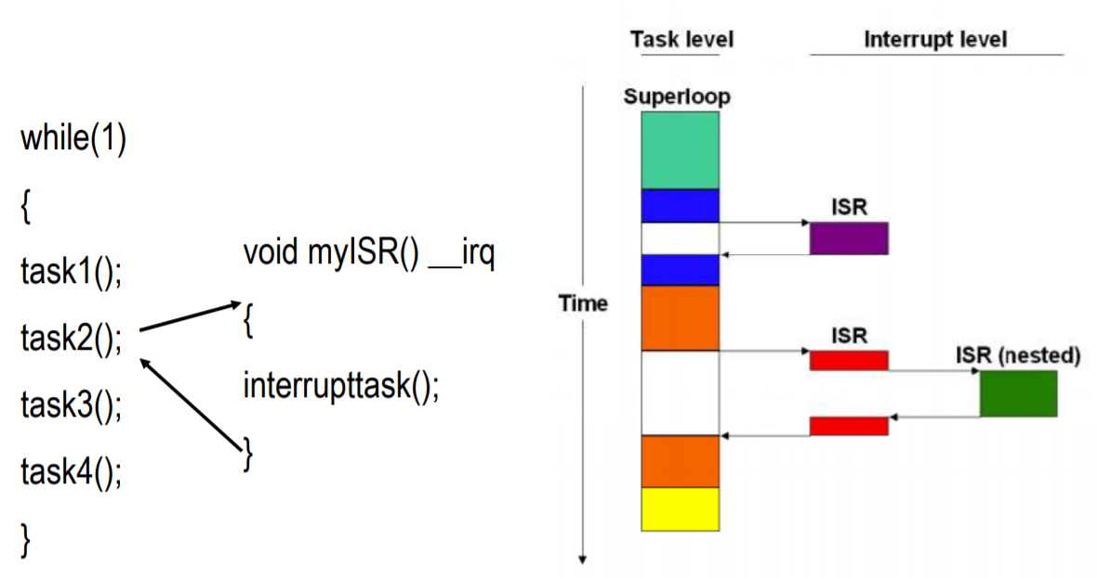
Single-task systems (superloop)
Time-critical operations must be processed within interrupts (ISR)
ISR nesting may create unpredictable execution time and stack requirements
Split of time-consuming functions that exceed Super-Loop cycle
This type of system is typically used in small, simple systems or if real-time behavior is not critical
Advantages
There are no inter-task synchronization problems with a superloop application.

Slide 16
These disadvantages of the Super-Loop concept are solved by using a Real-Time Operating System (RTOS).
System management - allows you to focus on application development rather than resource management
Multitasking - task scheduling gives the illusion of executing a number of tasks simultaneously
Deterministic behavior - events and interrupts are handled within a defined time
Inter-task communication - manages the sharing of data, memory, and hardware resources among multiple tasks
Defined stack usage - each task is allocated a defined stack space, enabling predictable memory usage
Task scheduling - tasks are called when needed ensuring better program flow and event response
Shorter ISRs - enables more deterministic interrupt behavior

Slide 17
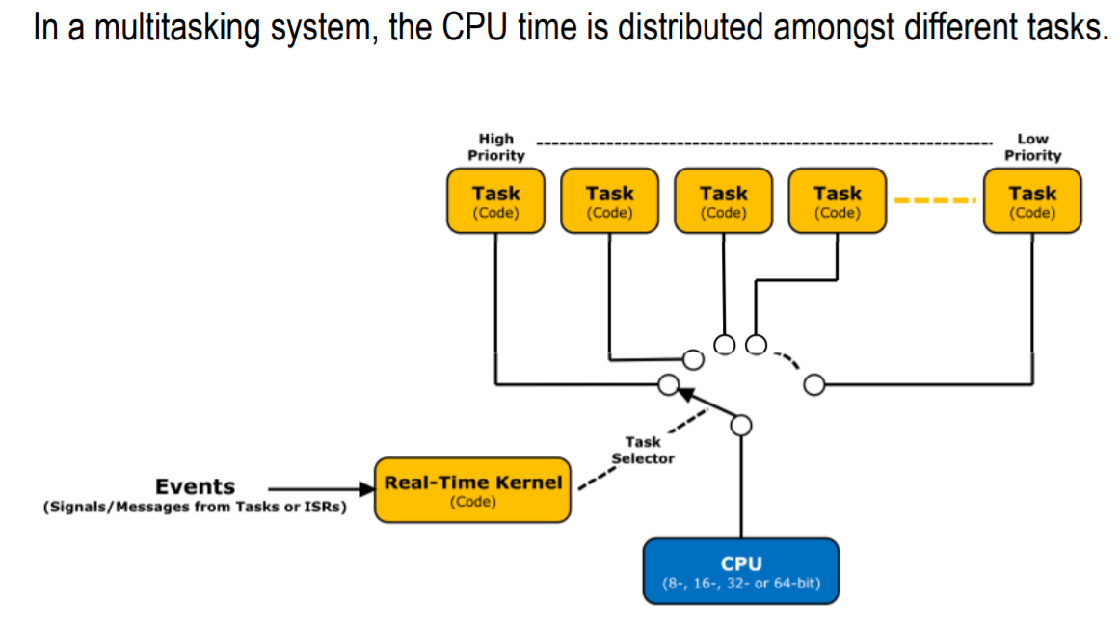
Multitasking System

Slide 18
Scheduling in RTOS
scheduling is the process of distributing the CPU time amongst different tasks.
To schedule the tasks, More information about the tasks should be known
– Number of tasks
– Resource Requirements
– Execution Time
– Deadline

Slide 19
Scheduling Algorithms in RTOS
Non-Priority based Scheduling
– Cyclic executive
– Shortest Task First
– Round Robin
• Priority Scheduling
– Cooperative Scheduling
– Preemptive Scheduling

Slide 20
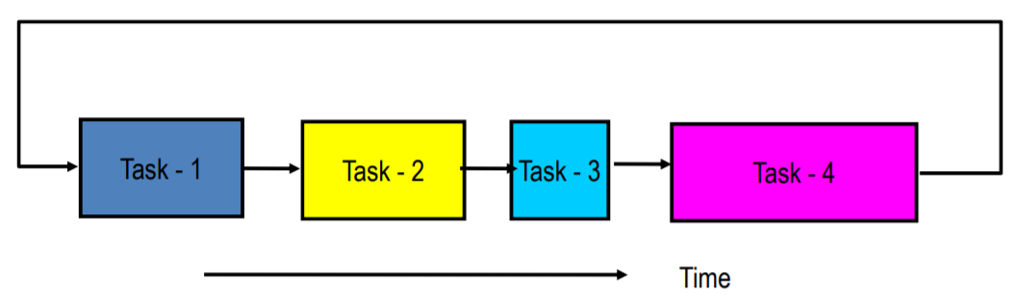
Cyclic executive
Tasks are arranged in Cyclic Fashion.
Each Task has to wait until the completion of previous task.

Slide 21
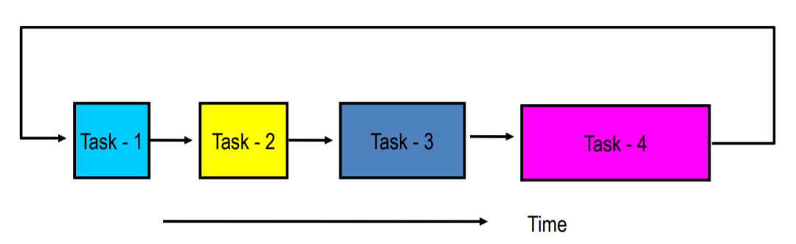
Shortest Task First
Tasks with shortest Execution time are executed first.
It requires precise knowledge of how long a task will run

Slide 22
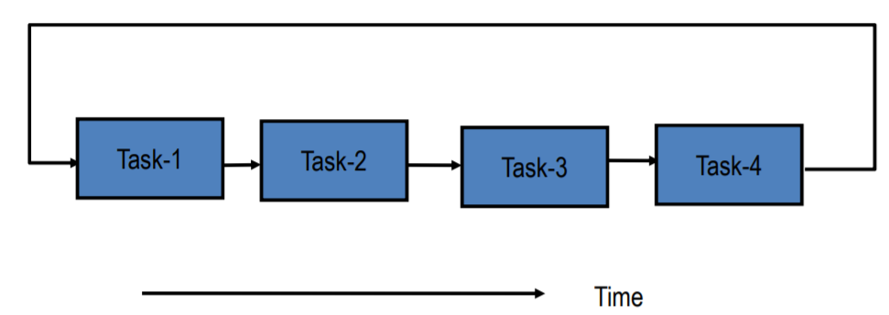
Round Robin Scheduling
Equal Time share of the CPU is given for all the Tasks.
CPU is given to the next task if
The current task completes before time slice
The current task uses the full time slice

Slide 23
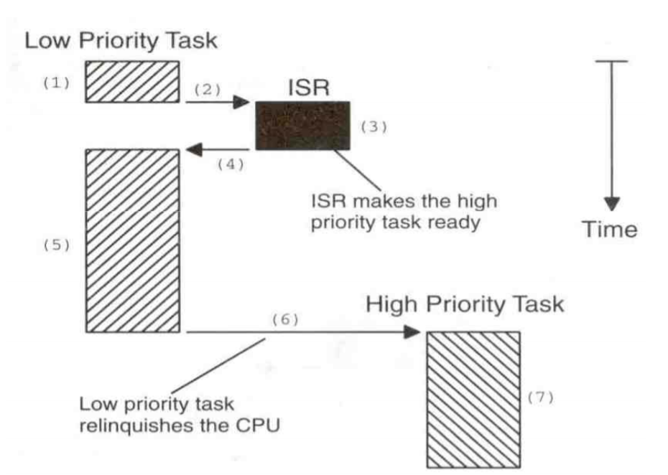
Cooperative Scheduling
Tasks are Prioritized.
Always High Priority Executes First.
In the event of a High Priority Task interrupting a Low Priority Task (Which is currently running), the Low Priority Task First Completes itself before giving the control to High Priority Task.

Slide 24
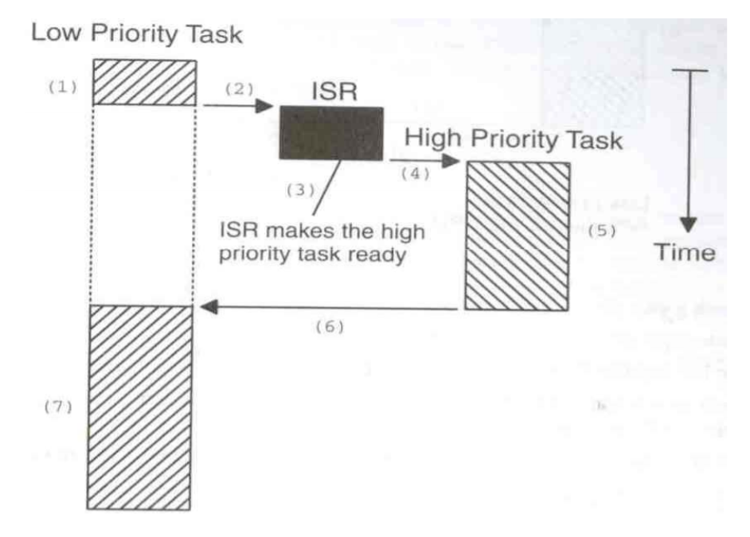
pre-emptive scheduling
Tasks are Prioritized.
Always High Priority Executes First.
In the event of a High Priority Task interrupting a Low Priority Task (Which is currently running), the High Priority Task Preempts the Low Priority Task and takes the control.

Slide 25
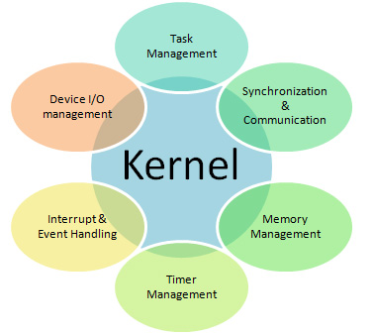
RTOS KERNEL SERVICES

Slide 26
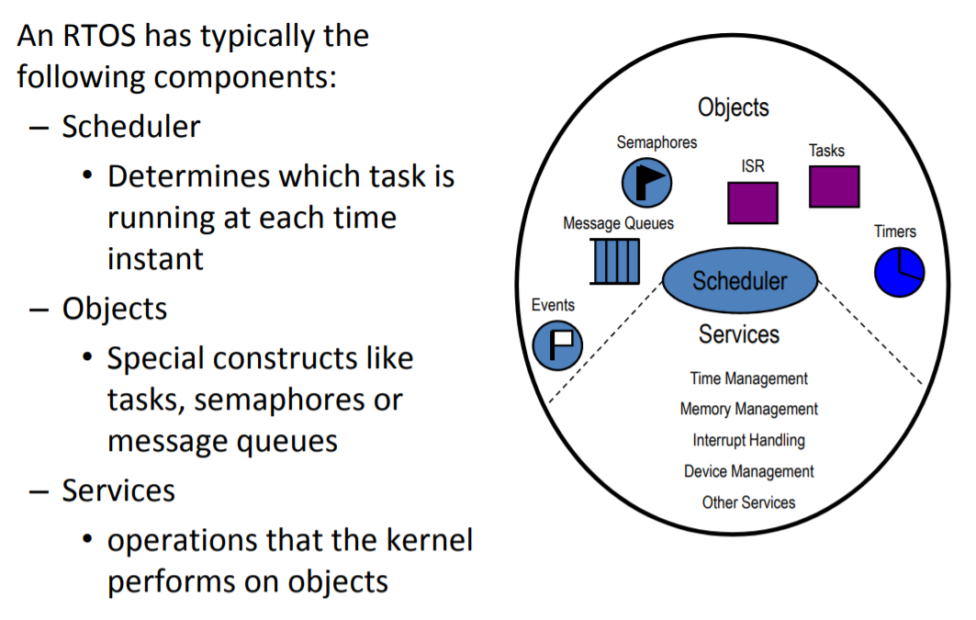
Components in an RTOS

Slide 27
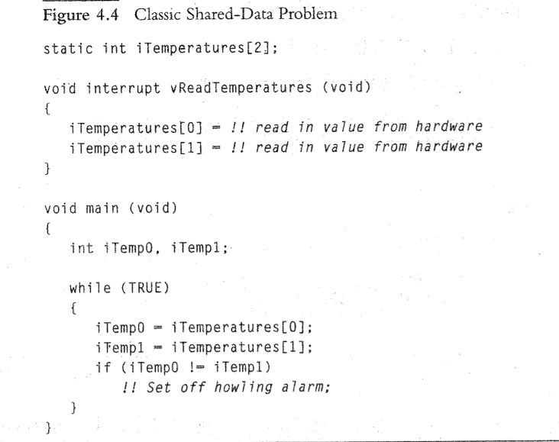
Shared Data problem
Critical section

Slide 28
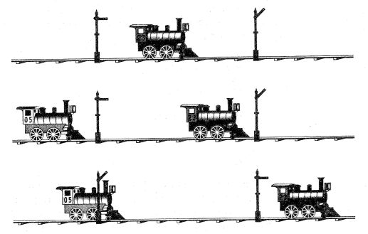
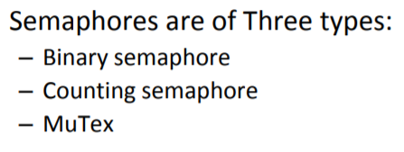
Semaphores
semaphore is a signaling mechanism, and a thread that is waiting on a semaphore can be signaled by another thread. It uses two atomic operations, 1)wait, and 2) signal for the process synchronization

Slide 29
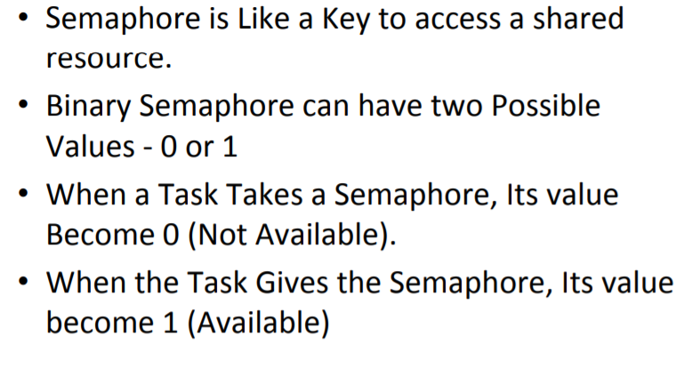
Binary semaphore

Slide 30
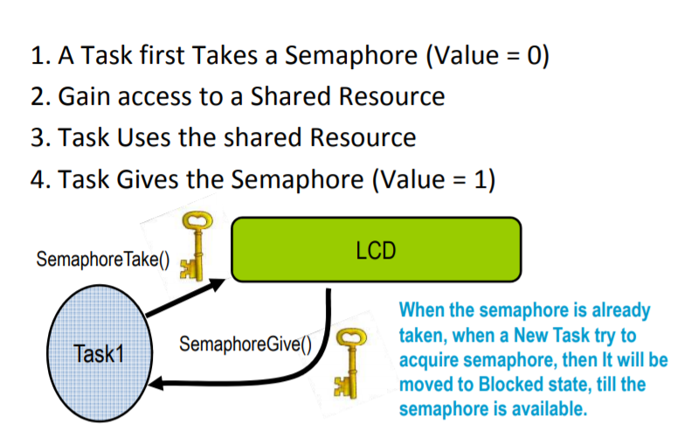
How to use Binary semaphore

Slide 31
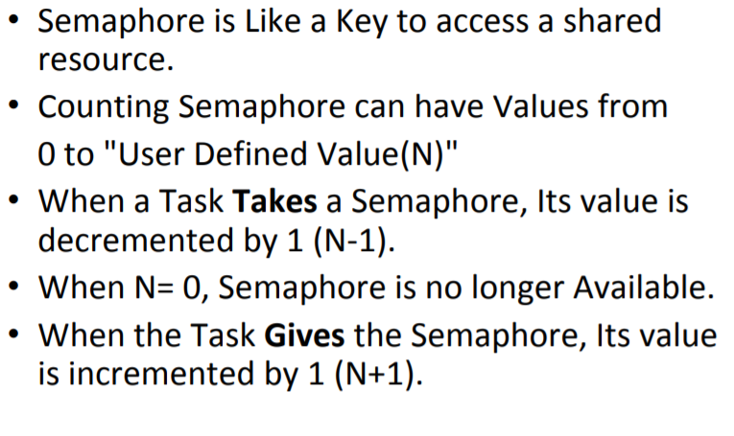
Counting Semaphore

Slide 32
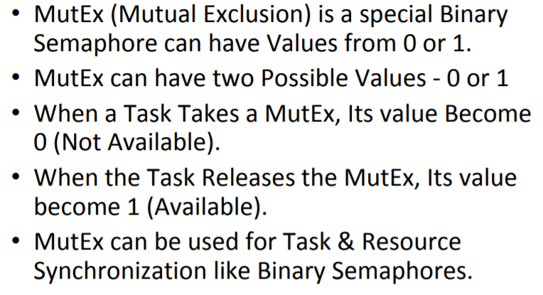
Mutex

Slide 33
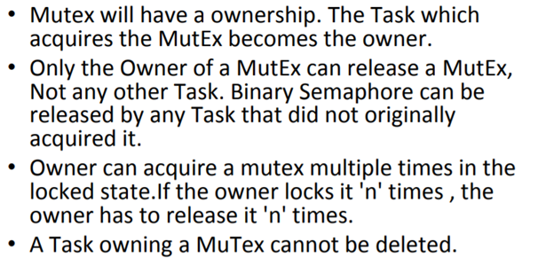
Mutex vs Binary semaphore

Slide 34
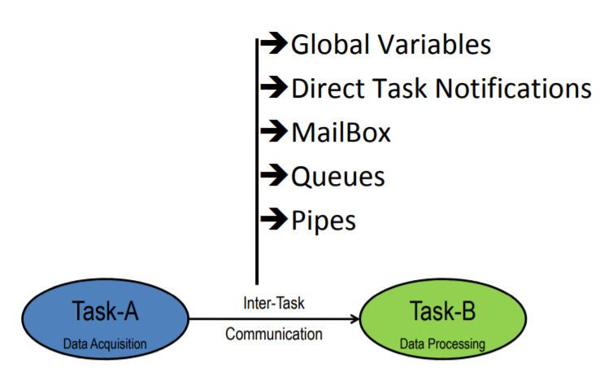
RTOS Objects for Inter-Task Communication

Slide 35
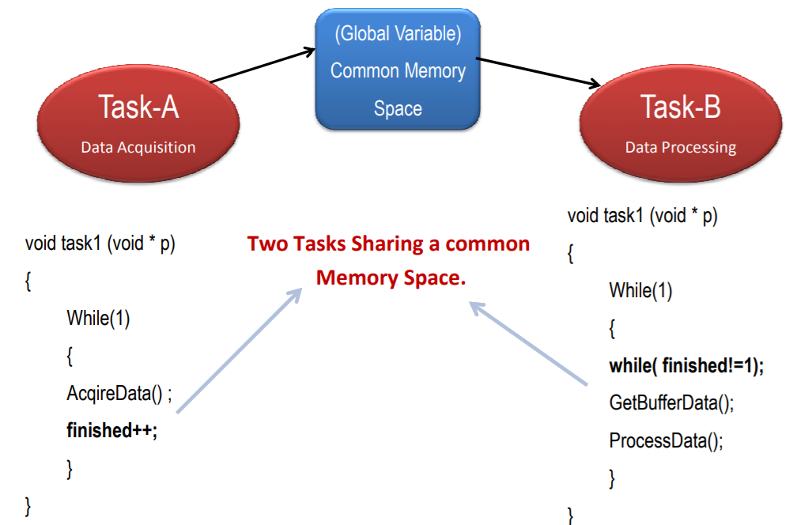
Global Variables

Slide 36
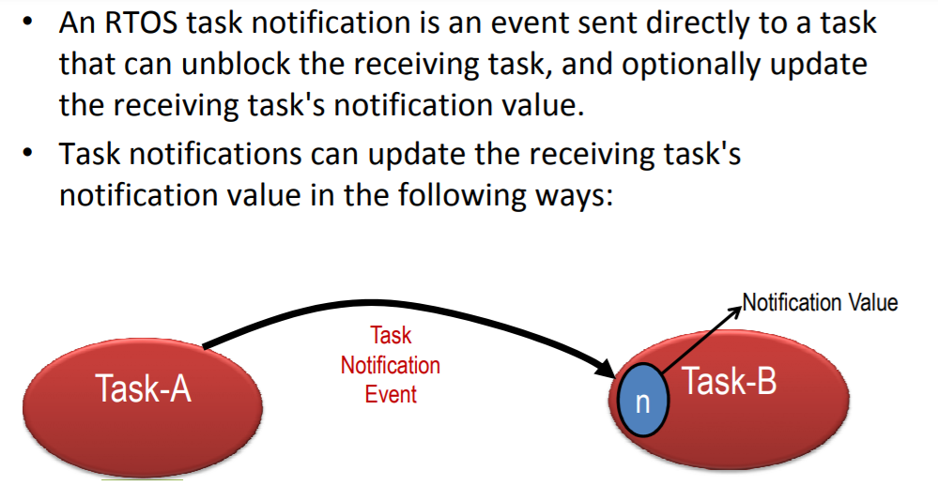
Direct Task Notifications

Slide 37
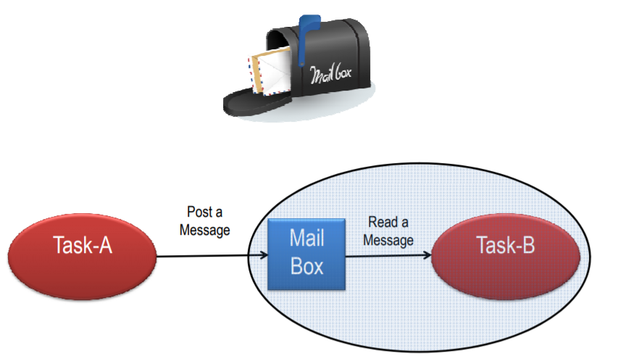
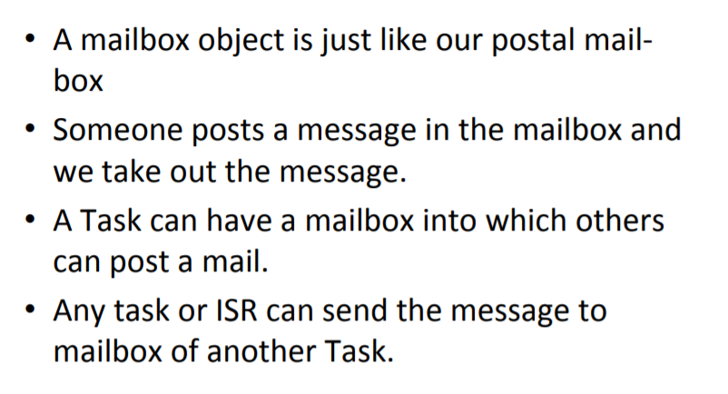
Mailbox

Slide 38
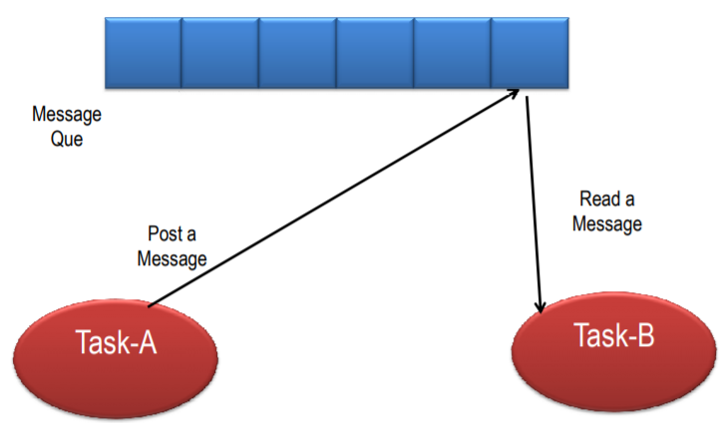
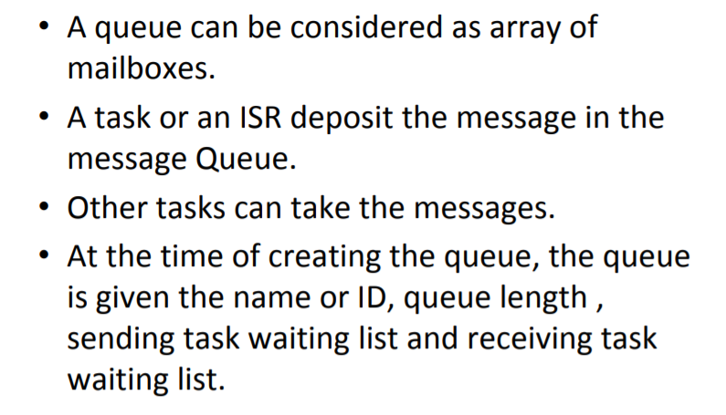
Queues

Slide 39
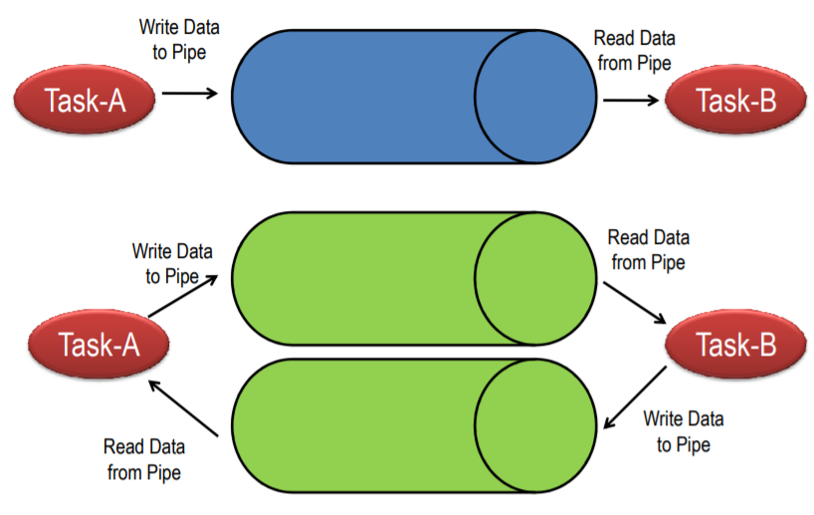
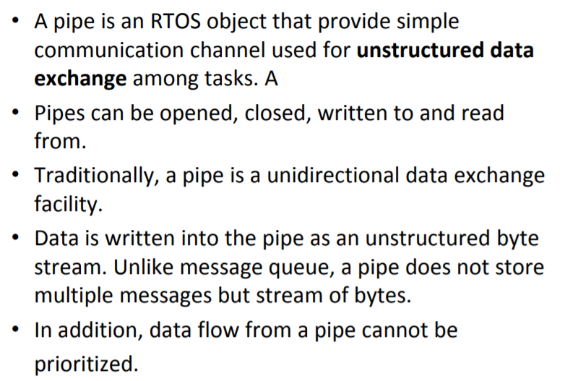
Pipes

Slide 40
Recap
How OS Works
Desktop OS Vs RTOS
Real Time Systems
Single Task Vs Multi tasking
Scheduling Algorithms in RTOS
Semaphores
Task Communication

Slide 41
Thank You

